Slide 1

Python For Machine Learning
UE19EC353
Department of ECE
PES University

Slide 2
Project 3 : Image Segmentation using K Means Clustering
Using K Means clustering for image segmentation
Writing K Means from scratch

Slide 3
Problem Statement
This project is one where you will implement K Means clustering from scratch and use it to perform image segmentation. The K Means Class in python should be written from scratch.
Scikit Learn based KMeans or OpenCV based Kmeans modules can be used for testing purposes only, i.e, to see how the output actually should turn up to be.

Slide 4
Image Segmentation
process of partitioning an image into meaningful segments/partitions
simplify and/or change the representation of an image into something that is more meaningful and easier to analyze
used to locate objects and boundaries (lines, curves, etc.)
Applications include Medical Imaging, object detection,etc

Slide 5
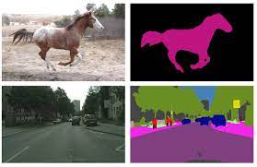
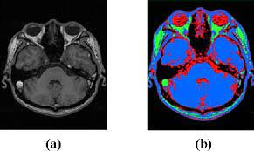
Image Segmentation

Slide 6
Image Segmentation Algorithms
Binary Thresholding
Watershed Algorithm
K Means Clustering
Graph Based
Fuzzy Means
Support Vector Machines
Advanced : UNet CNN architectures

Slide 7
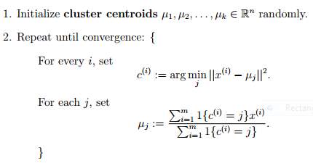
Understanding K Means Working

Slide 8
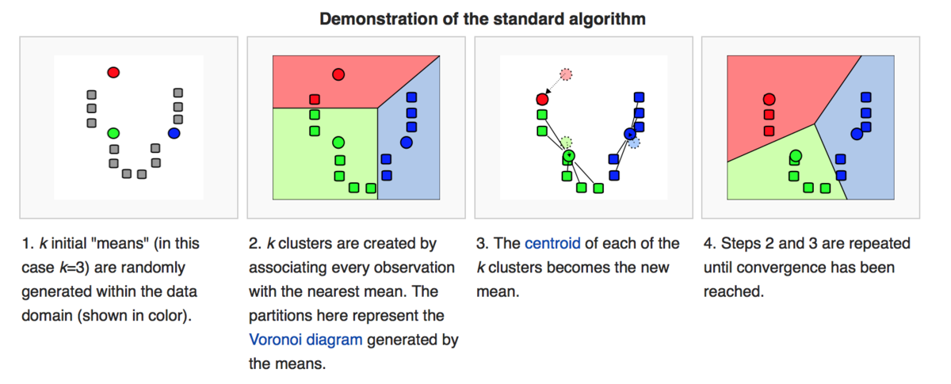
Understanding K Means Working

Slide 9
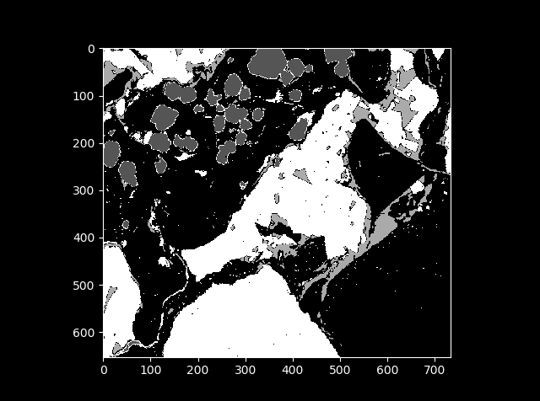
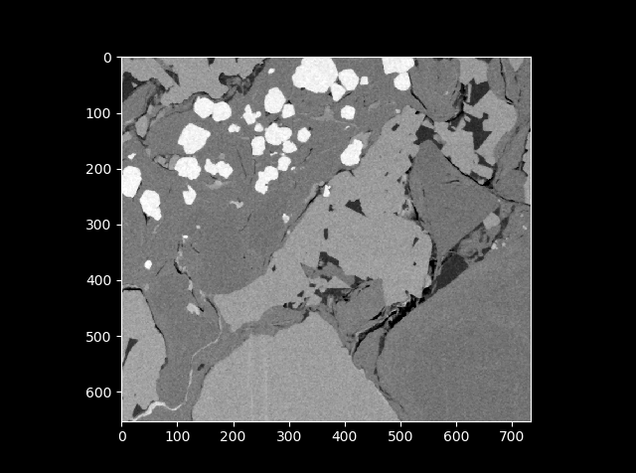
Building K Means from scratch

